Slide 1
CLOUD COMPUTING

Slide 2
What is Cloud Computing?
Cloud Computing is the practice of using a network of remote servers hosted on the internet to store, manage, and process data, rather than a local server or a personal computer
The “Cloud” is a term that simply means “the internet.” Computing involves the infrastructures and systems that allow a computer to run and build, deploy, or interact with information. In cloud computing, this means that instead of hosting infrastructure, systems, or applications on your hard drive or an on-site server, you’re hosting it on virtual/online servers that connect to your computer through secure networks.
The main fundamental blocks of Cloud Computing are
Compute
Storage
Database
Networking
Security

Slide 3
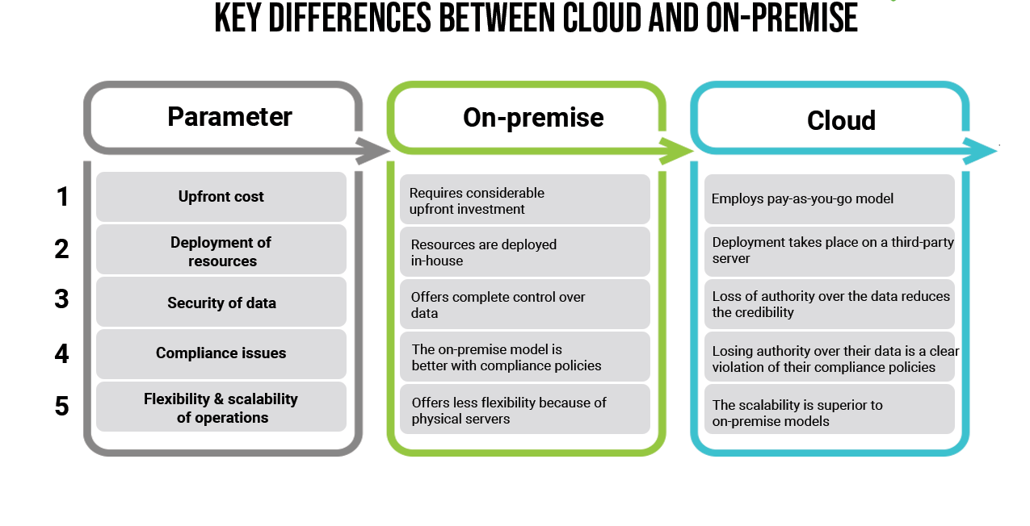
On-premises vs. Cloud
On-premise software is installed locally, on your business' computers and servers, where cloud software is hosted on the vendor's server and accessed via a web browser.

Slide 4
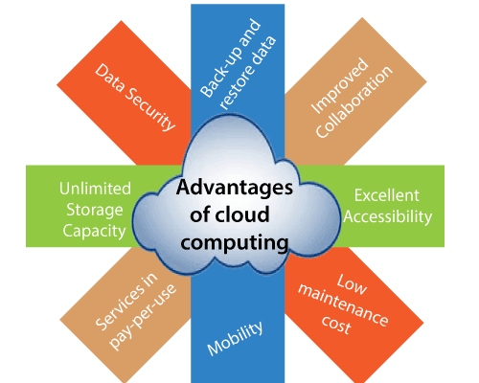
Advantages of Cloud Computing

Slide 5
Back-up and restore data:
Once the data is stored in the cloud, it is easier to get back-up and restore that data using the cloud.
Improved collaboration:
Cloud applications improve collaboration by allowing groups of people to quickly and easily share information in the cloud via shared storage.
Excellent accessibility:
Cloud allows us to quickly and easily access store information anywhere, anytime in the whole world, using an internet connection. An internet cloud infrastructure increases organization productivity and efficiency by ensuring that our data is always accessible.
Low maintenance cost:
Cloud computing reduces both hardware and software maintenance costs for organizations.
Mobility:
Cloud computing allows us to easily access all cloud data via mobile.
IServices in the pay-per-use model:
Cloud computing offers Application Programming Interfaces (APIs) to the users for access services on the cloud and pays the charges as per the usage of service.
Unlimited storage capacity:
Cloud offers us a huge amount of storing capacity for storing our important data such as documents, images, audio, video, etc. in one place.
Data security:
Data security is one of the biggest advantages of cloud computing. Cloud offers many advanced features related to security and ensures that data is securely stored and handled.

Slide 6
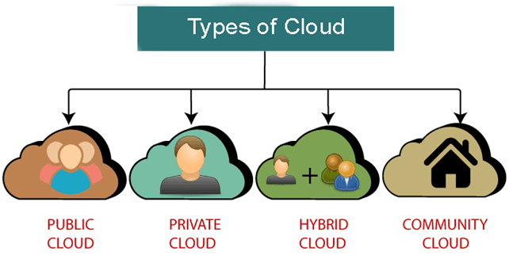
Types of Cloud

Slide 7
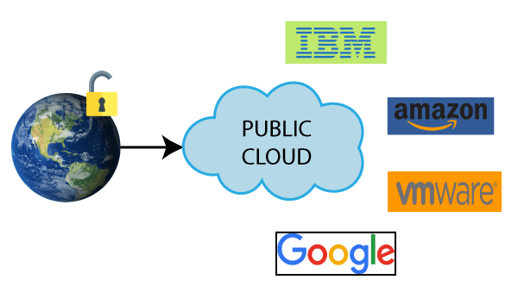
Public Cloud: Public cloud is open to all to store and access information via the Internet using the pay-per-usage method. In public cloud, computing resources are managed and operated by the Cloud Service Provider (CSP). Example: Amazon elastic compute cloud (EC2), IBM Smart Cloud Enterprise, Microsoft, Google App Engine, Windows Azure Services Platform.

Slide 8
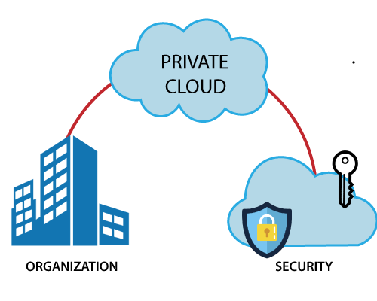
Private Cloud: Private cloud is also known as an internal cloud or corporate cloud. It is used by organizations to build and manage their own data centers internally or by the third party. It can be deployed using Open source tools such as Open stack and Eucalyptus. Based on the location and management, National Institute of Standards and Technology (NIST) divide private cloud into the following two parts- 1.On-premise private cloud 2.Outsourced private cloud Example: HP Data Centers, Microsoft, Elastra-private cloud, and Ubuntu are the example of a private cloud

Slide 9
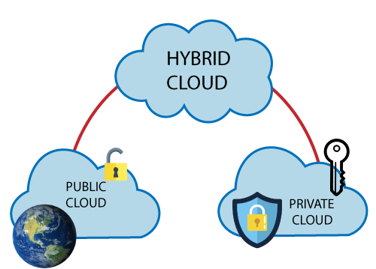
Hybrid Cloud: Hybrid Cloud is a combination of the public cloud and the private cloud. Hybrid cloud is partially secure because the services which are running on the public cloud can be accessed by anyone, while the services which are running on a private cloud can be accessed only by the organization's users. Example: Google Application Suite (Gmail, Google Apps, and Google Drive), Office 365 (MS Office on the Web and One Drive), Amazon Web Services.

Slide 10
Why Cloud?
Let's look at some of the most common reasons to use the cloud.
File storage: You can store all types of information in the cloud, including files and email.
File sharing: The cloud makes it easy to share files with several people at the same time.
Backing up data: You can also use the cloud to protect your files.

Slide 11
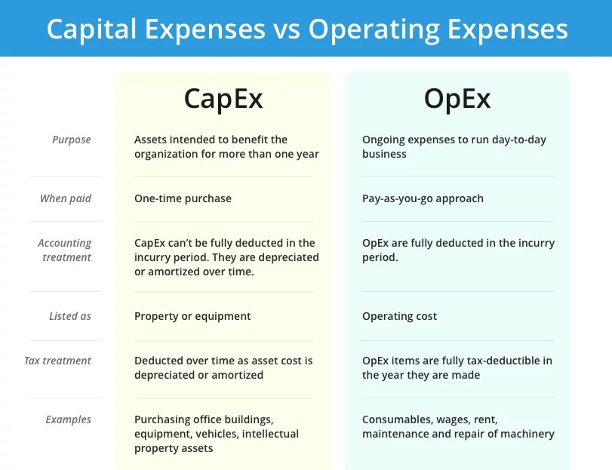

Slide 12
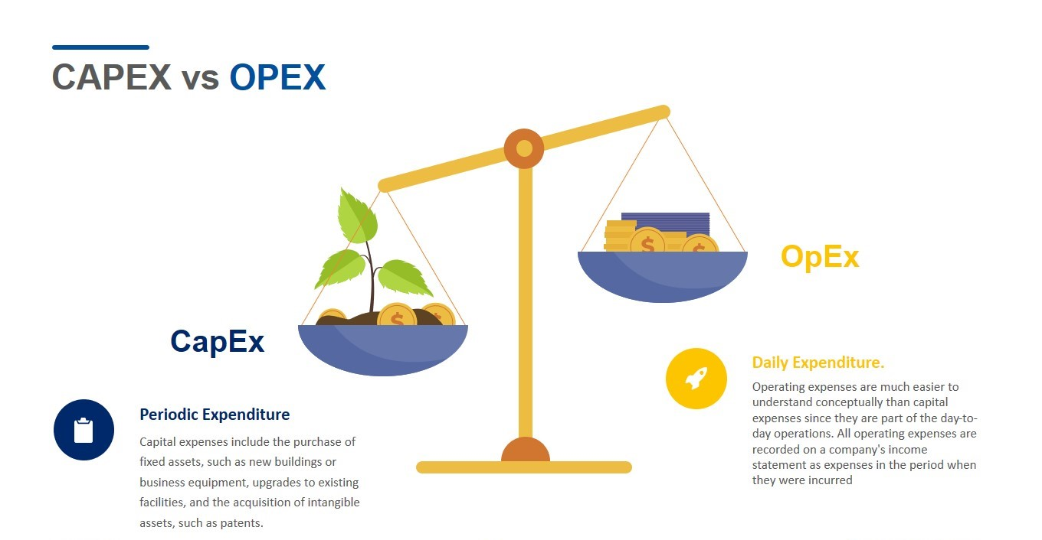

Slide 13
Thank You!!

